Slide 1
CHAPTER- 6
UNDERSTANDING MEDIA

Slide 2
WHAT IS MEDIA?
1. In general, "media" refers to various means of communication. For example, television, radio, and the newspaper are different types of media.
2. a plural of medium

Slide 3
WHAT IS MASS MEDIA?
Mass media means technology that is intended to reach a mass audience. It is the primary means of communication used to reach the vast majority of the general public.

Slide 4
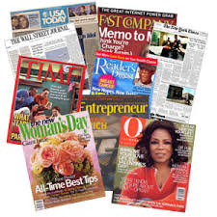
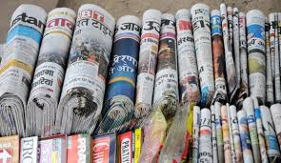
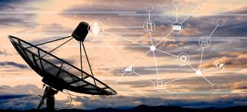
Two types of Mass media
Print media is that means of mass communication through which information is disseminated in printed form.
Electronic media is one in which electronic or electromechanical energy is employed to transmit information to the audience.

Slide 5
Relation between media and money
Money is the largest deciding factor between media products and their audiences

